Slide 1
Course Overview

Slide 2
Introduction
About System Analysis Steps
PMP vs Agile (PM vs PO, and Scrum Master)
Career path: Developer, Senior Developer ,Team Lead, System Analyst, System Architecture, Project Manager
Mobile
Flutter, React-Native
Web-Technology
Backend: Python Django 3.0, ASP.net core 5.0
Frontend: VueJS, React + Bootstrap 5.0
Database
SQL Server, MySQL/ MariaDB, DB2 Oracle
Advanced Topics
MQ/Kafka , Solr 8, Blockchain, Big Data/Hadoop, Redis

Slide 3
Prerequisites
List the resources you used
Android Studio
Durt
Visual Studio 2019 Community Edition
SQL Server 2019 Express
Python 3.5
GitHub account

Slide 4
How to Install Prerequisites software
Flutter
https://www.youtube.com/watch?v=fDnqXmLSqtg
SQL Server 2019
https://www.youtube.com/watch?v=1UdmrVIBzN4
VS 2019
https://www.youtube.com/watch?v=BB2Qn7YM9aA
Install Latest Python
https://www.youtube.com/watch?v=UvcQlPZ8ecA

Slide 5
SQL Commands
https://www.w3schools.com/sql/sql_select.asp

Slide 6
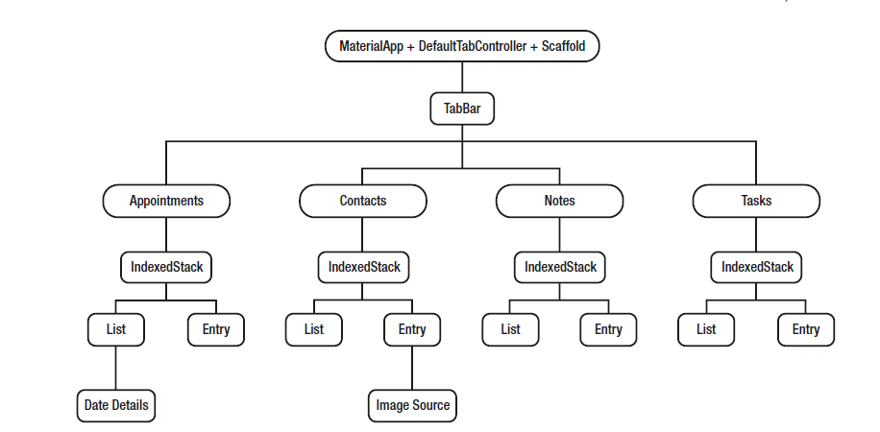

Slide 7
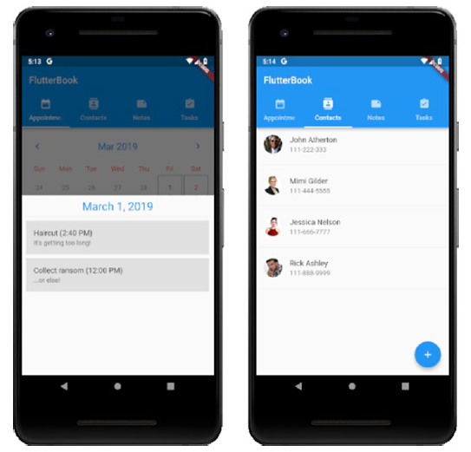
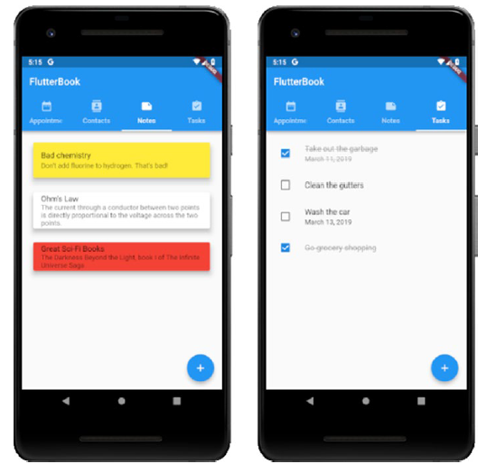

Slide 8
Questions & answers
Invite questions from the audience.

